Slide 1


Welcome to the
presentation MAT-101

Slide 2









MEET THE GROUP
UMME SUMAYA 2022-2-60-035
JANNATUL FERDOUS PROME 2022-2-60-031
ABRAR HOSSAIN ZAHIN 2022-2-60-040
SADIA AFRIN 2022-2-60-037

Slide 3

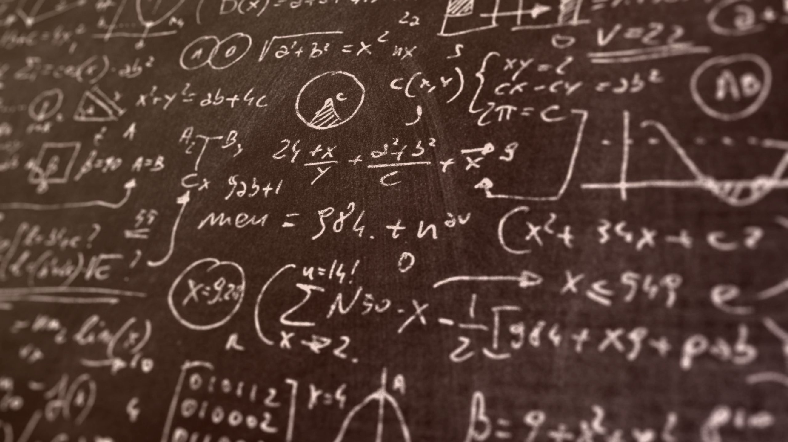
Application of Calculus in Video Games

Slide 4



Contents
What is calculus?
How is calculus used in video games?
Is calculus necessary for video games?
In video games what happens if we don’t use calculus?

Slide 5
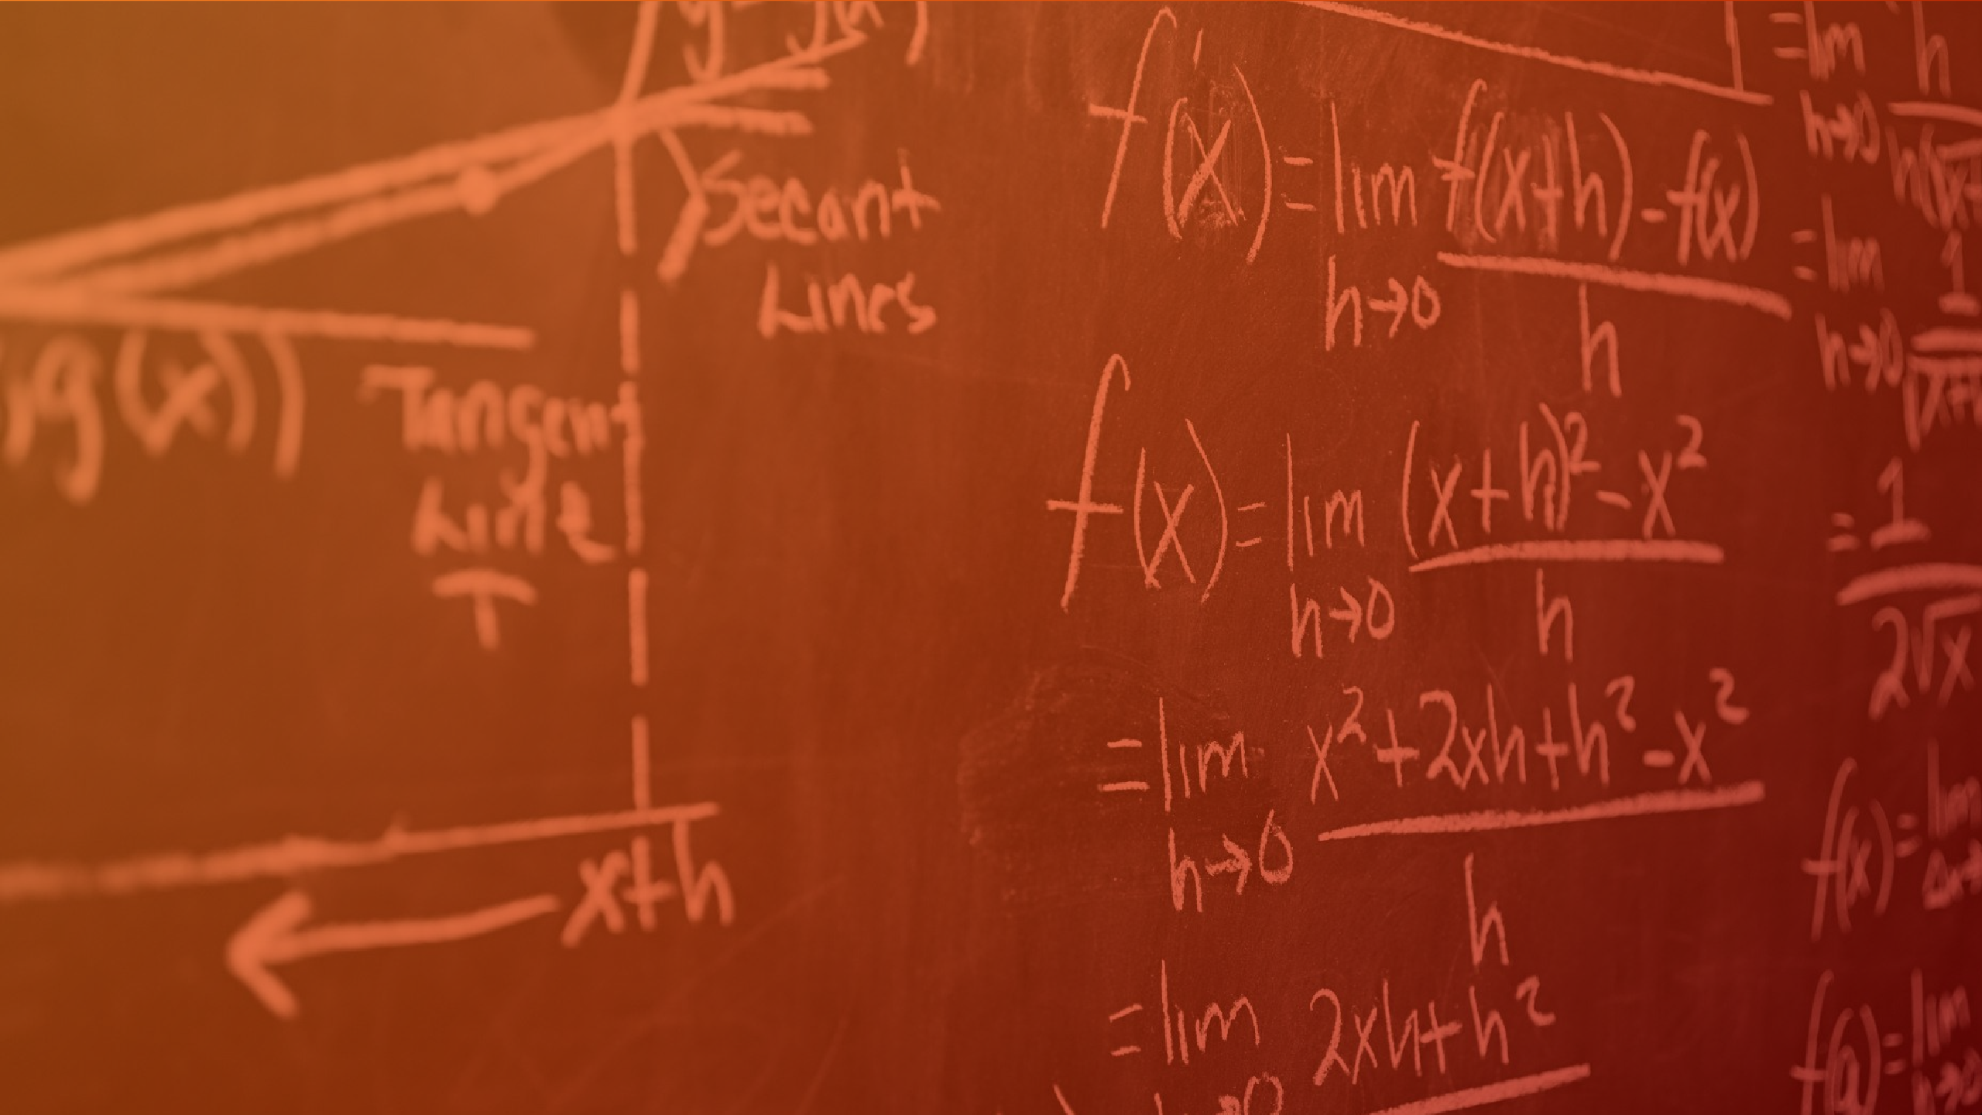

What is calculus ?
Calculus is a branch of mathematics that involves study of rates of changes.
Engineeri ng
Invented
Calculus
Gaming
Medicin e
Isaac Newton
Gottfried Leibniz
Calculus
Integral calculus
Differential calculus
Physics
Statistics
Economics

Slide 6















How is calculus used in vedio games ?
.
Initially the calculus of physics engines in video games was offered to detecting collisions between in-game objects (such as player characters, rocks, and dust particles) and enacting appropriate responses .
Integral calculus
Simulate the bouncing of light, subdivision .
Geometry are used in creating smooth surfaces .
Harmonic coordinates are used in making characters move realistically .
Differential calculus
□ It equations are used in classical mechanics to describe the dynamics of a set of point masses subject to a force chosen by the human player, elastic forces and friction forces .

Slide 7
IS CALCULUS NECESSARY FOR VIDEO GAMES ?
Calculus creates the physics of video games universes and complex matrices allow computers to challenge gamers with artificial intelligence. It ultimately plays an important role in how such an engine explain data from a simulation and provides an appropriate response. Can’t imagine such a complex subject without calculus.

Slide 8


What happens if we don’t use calculus in video games ?

Slide 9

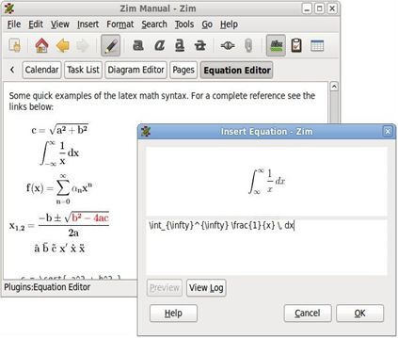
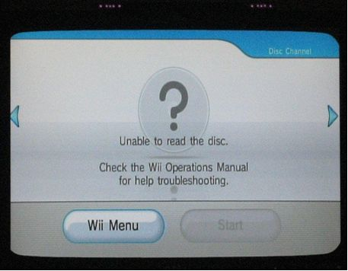
Without Calculus we can’t explain any video games.

Slide 10




In video games calculus might help us like….
Constructing some basic concepts
Practical motivation
Integrals to calculate more quickly
Giving by some tools

Slide 11

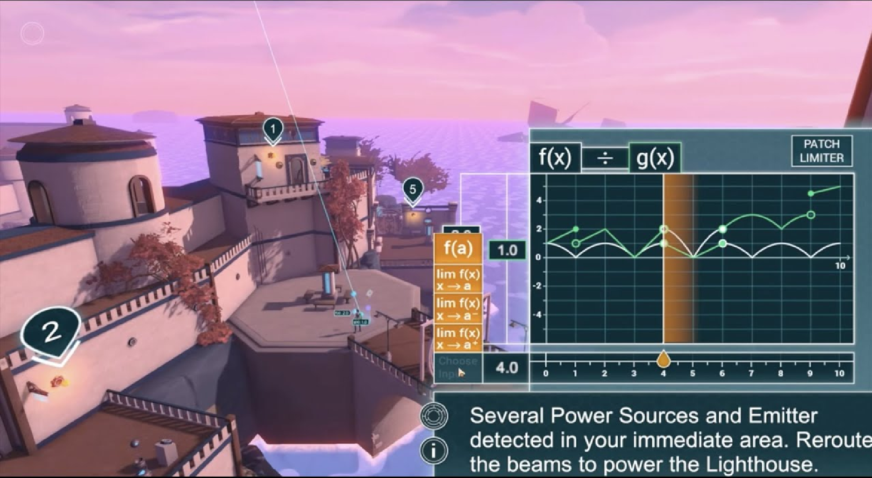
Video games try to obey Mathematical laws. Resulting trajectory may be found by calculus.
So if we don’t use calculus it can’t be perfect.

Slide 12






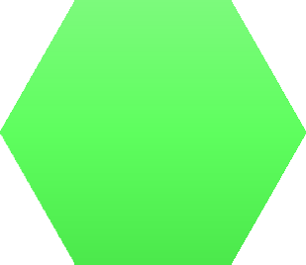
If we don’t use calculus in video games we won’t be able to do this
Function
And so many other things.
Topolog y
Calculus
Differentia bility
Continuity
Limits

Slide 13
References
https://www.google.com/search?q=application+of+calculus+in+video+games&client=safari&channel=mac_bm &sxsrf=ALiCzsaSjDhMvUwR5z0ifFSxenooabKqxA%3A1660930909848&source=hp&ei=Xcv_YqC3MfrQseMP-ciwyAY& iflsig=AJiK0e8AAAAAYv_Zbe8JZHj-srapljKcu0a3o6sEhr3y&oq=&gs_lcp=Cgdnd3Mtd2l6EAEYATIHCCMQ6gIQJzIHCC MQ6gIQJzINCC4QxwEQ0QMQ6gIQJzIHCC4Q6gIQJzIHCCMQ6gIQJzIHCCMQ6gIQJzIHCCMQ6gIQJzIHCCMQ6gIQJzIHCC
MQ6gIQJzIHCCMQ6gIQJ1AAWABgt7oDaAJwAHgAgAGJAogB1xKSAQUwLjcuNZgBALABCg&sclient=gws-wiz
https://www.youtube.com/results?search_query=application+of+vedio+games+some+example
https://www.google.com/search?q=how+to+use+differential+calculus+in+video+games&client=safari&chan nel=mac_bm&sxsrf=ALiCzsadLg09RENTw-sQSSnX2WW_F9T-SA%3A1660975236456&source=hp&ei=hHgAY73b GNDT2roPrf6HgAE&iflsig=AJiK0e8AAAAAYwCGlEvfckwL9h9W6krQEmp8skfQqXz4&oq=&gs_lcp=Cgdnd3Mtd2l6 EAEYBTIHCCMQ6gIQJzIHCCMQ6gIQJzINCC4QxwEQ0QMQ6gIQJzIHCC4Q6gIQJzIHCCMQ6gIQJzIHCCMQ6gIQJzIHC CMQ6gIQJzIHCCMQ6gIQJzIHCCMQ6gIQJzIHCCMQ6gIQJ1AAWABggzRoAXAAeACAAQCIAQCSAQCYAQCwAQo&scli
ent=gws-wiz

Slide 14



Thank you all for watching our presentation.
Do you have any question for us ?

